Slide 1
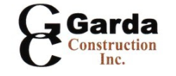
Polished steel rail, post and gate arm with upgraded acrylic signage Polished steel rail, post and gate arm with upgraded acrylic signage
Garda your Assets with our turnkey solutions

Slide 2
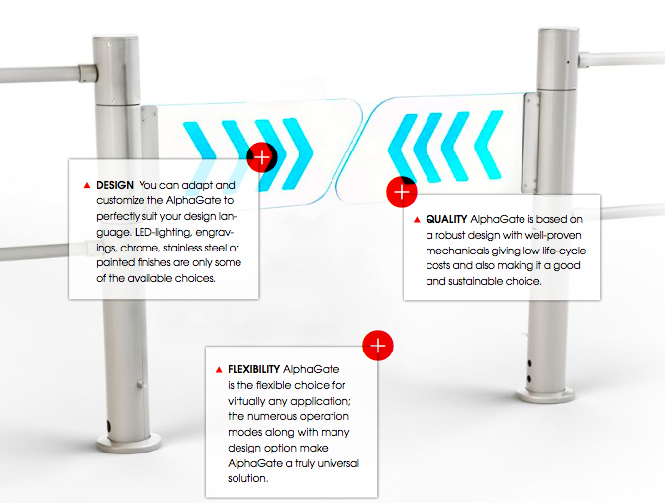
ITAB ALPHA GATE MKll
M

Slide 3
GARDA’S ALPHA GATE
Reliability - Best in class automatic gate
Robust Materials - High quality construction & customized to the US retail market
Safety and Protection - Child Safety Sensor
Customization - Opening Controls, Built in Radars, Gate layouts, Custom Logo, Custom color configurations and LED gate arms

Slide 4
Types of Garda’s Alpha Gate
1. CLASSIC
2. ACRYLIC SIGNAGE w/ Custom Store Logo
3. LED ACRYLIC SIGNAGE w/ Custom Store Logo
4. APPEARANCE PACKAGE

Slide 5
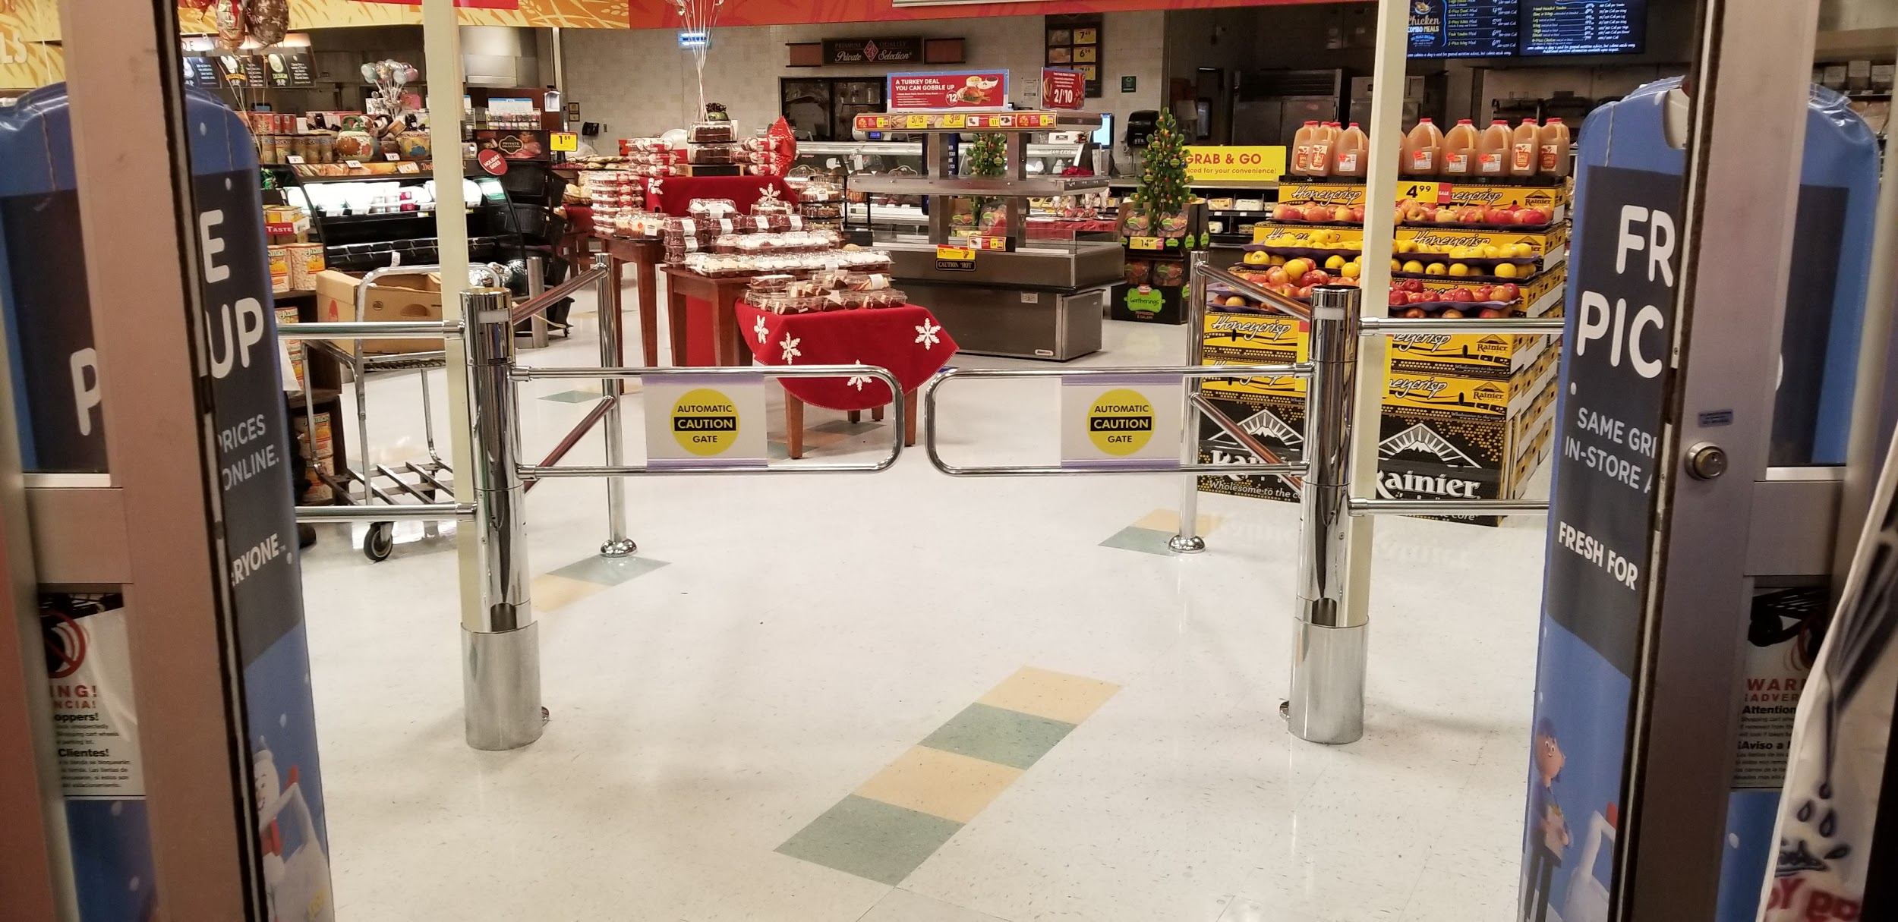
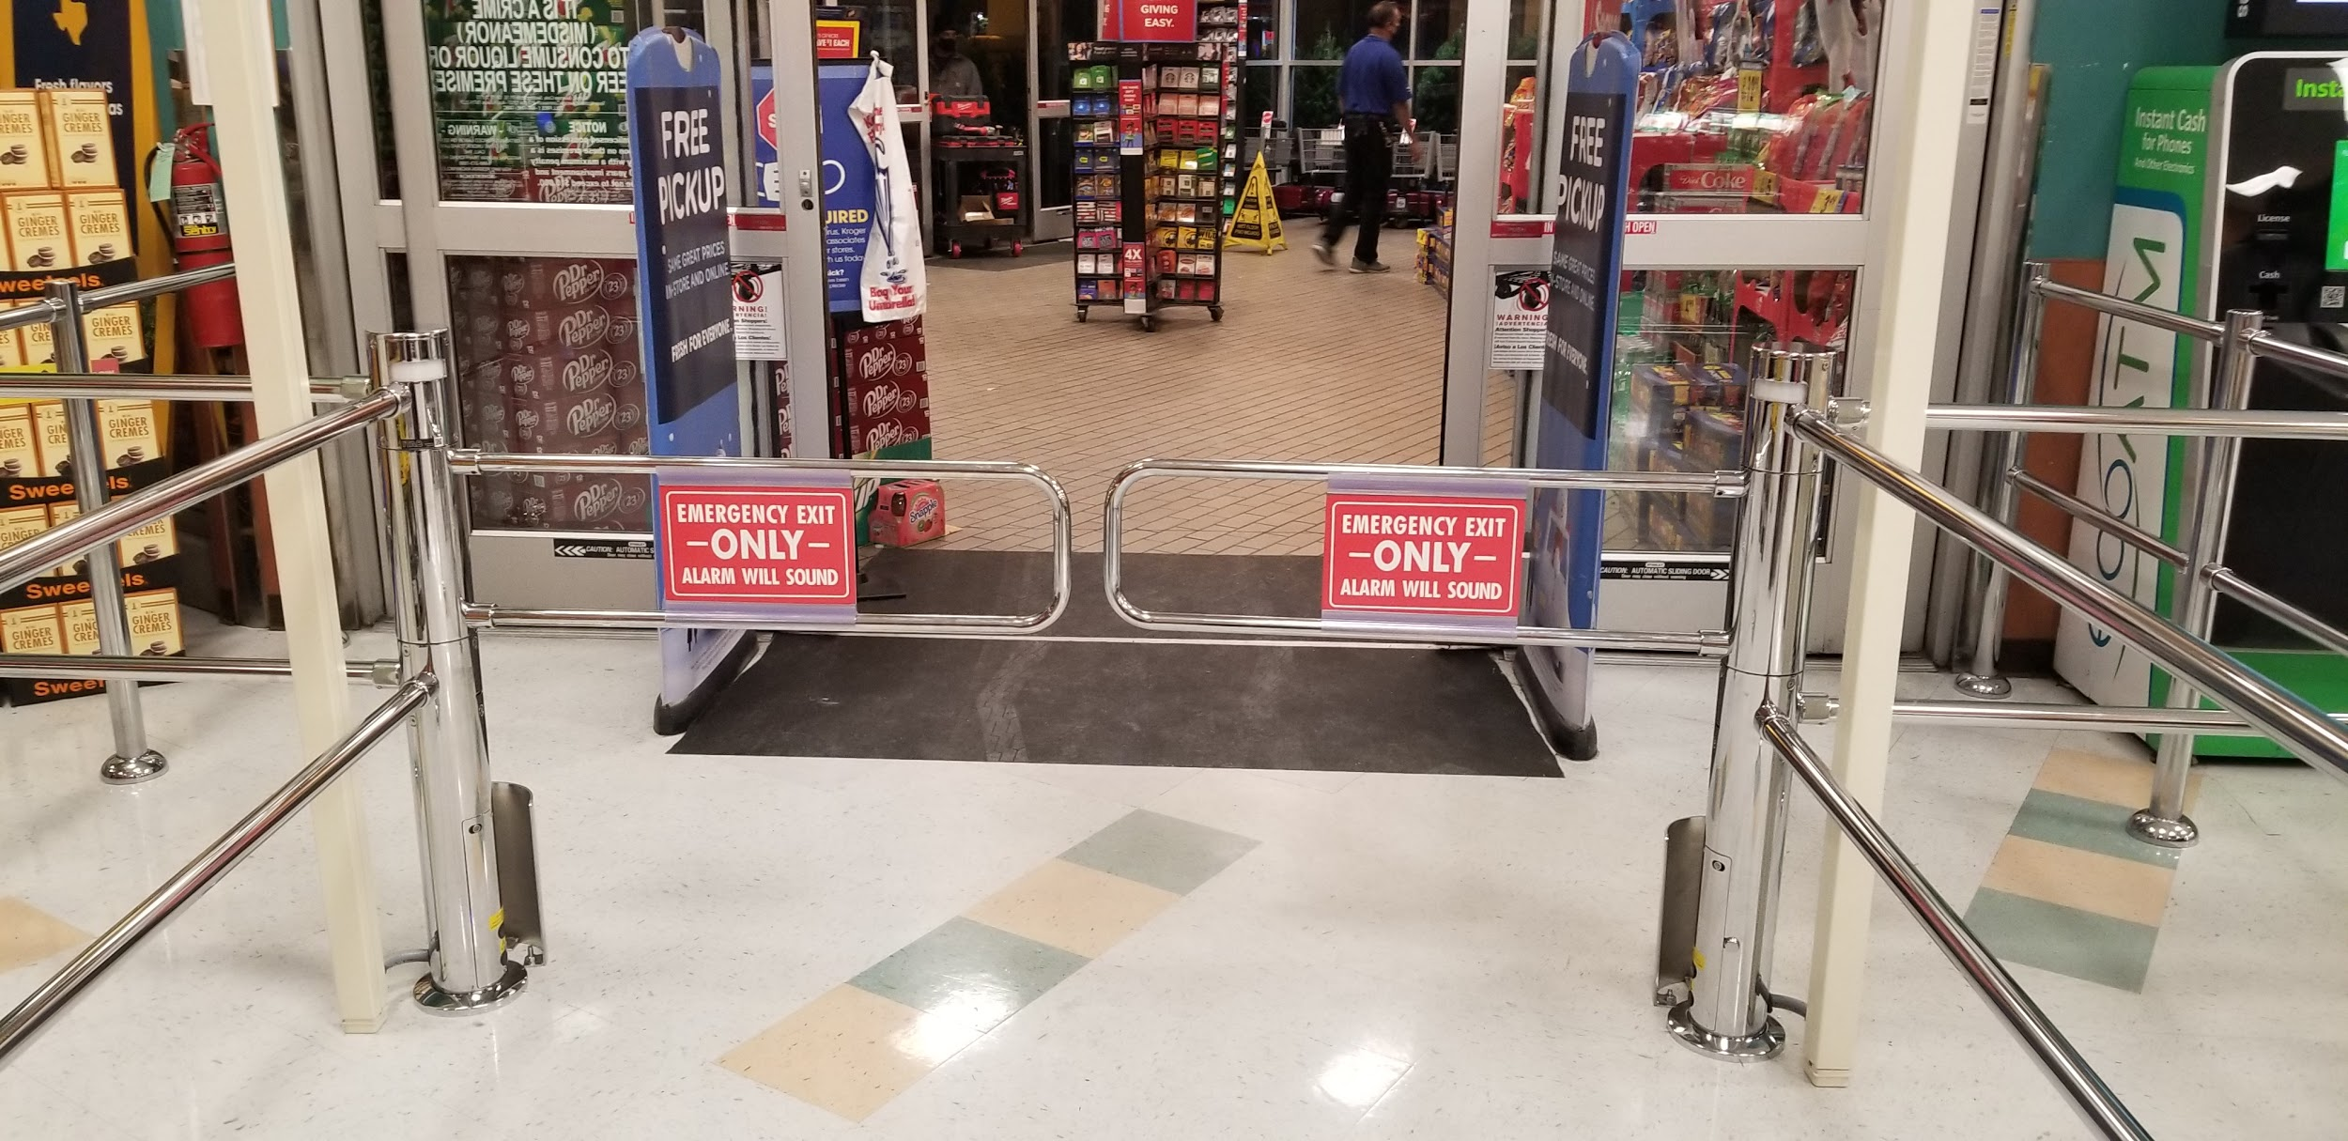
CLASSIC
Acrylic Sign with classic signage and polished steel post, rail and gates
(Caution Automatic Gate)
(EMERGENCY EXIT ONLY ALARM WILL SOUND)

Slide 6
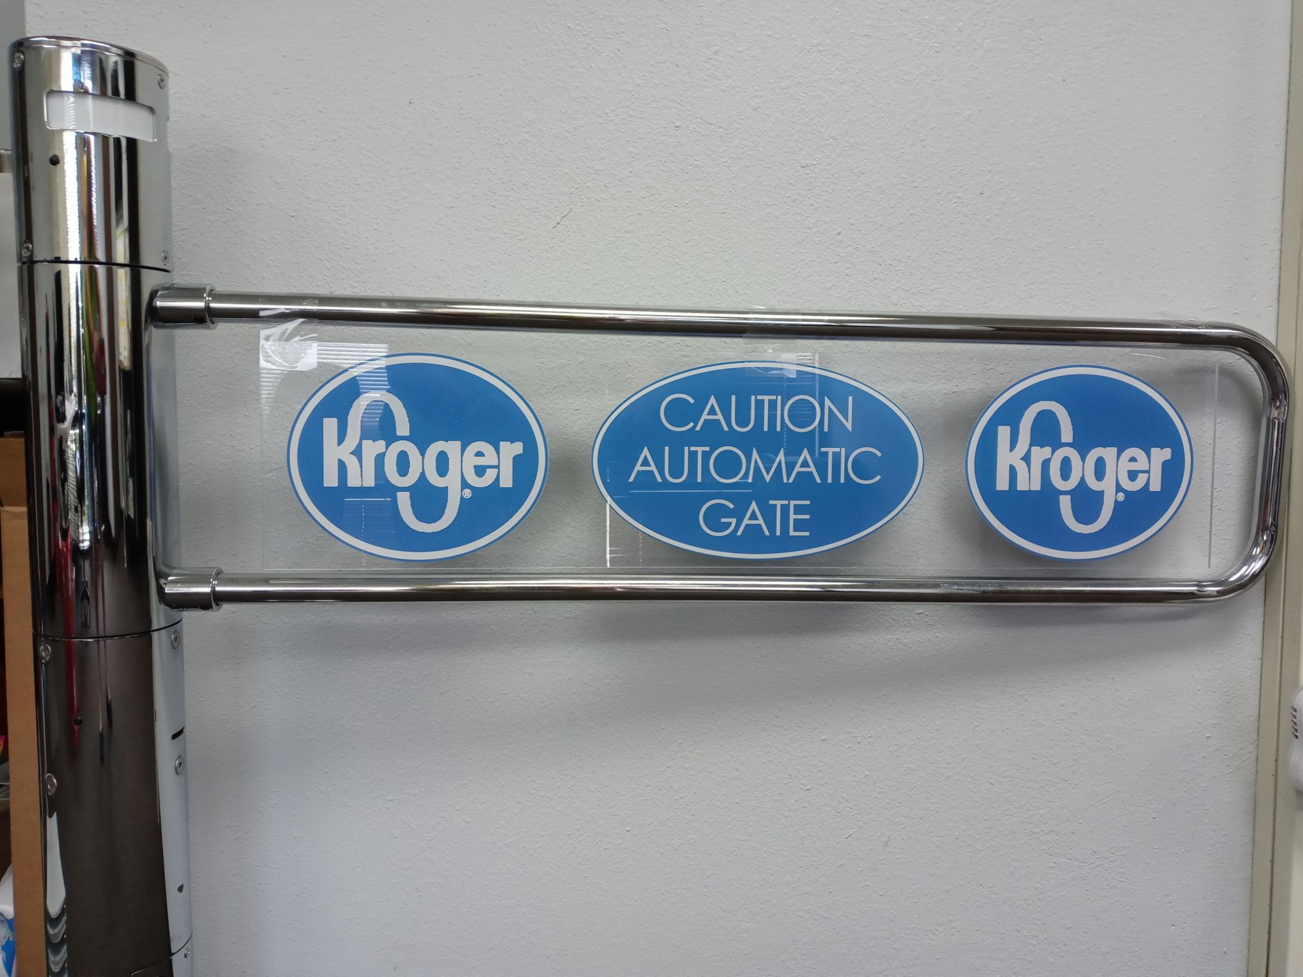
ACRYLIC SIGNAGE W/ CUSTOM STORE LOGO
Polished steel rail, post and gate arm with upgraded acrylic signage
Post and rail can be upgraded as well
*For prototype example only*

Slide 7
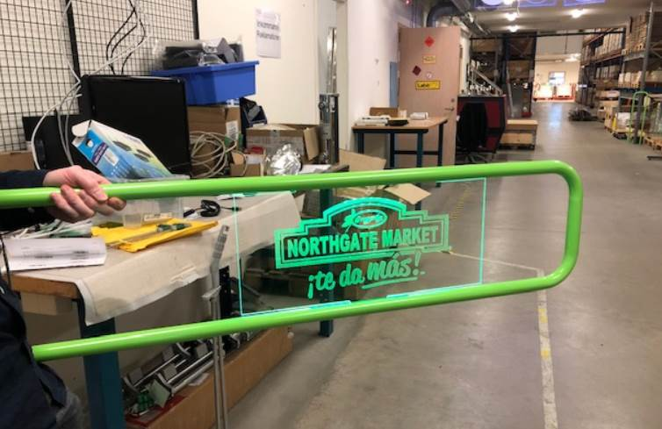
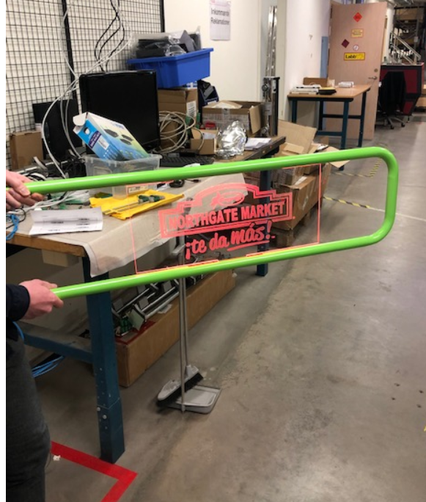
LED ACRYLIC SIGNAGE W/ CUSTOM STORE LOGO
Polished steel rail, post and gate arm with upgraded acrylic LED signage
Post and rail can be upgraded as well

Slide 8
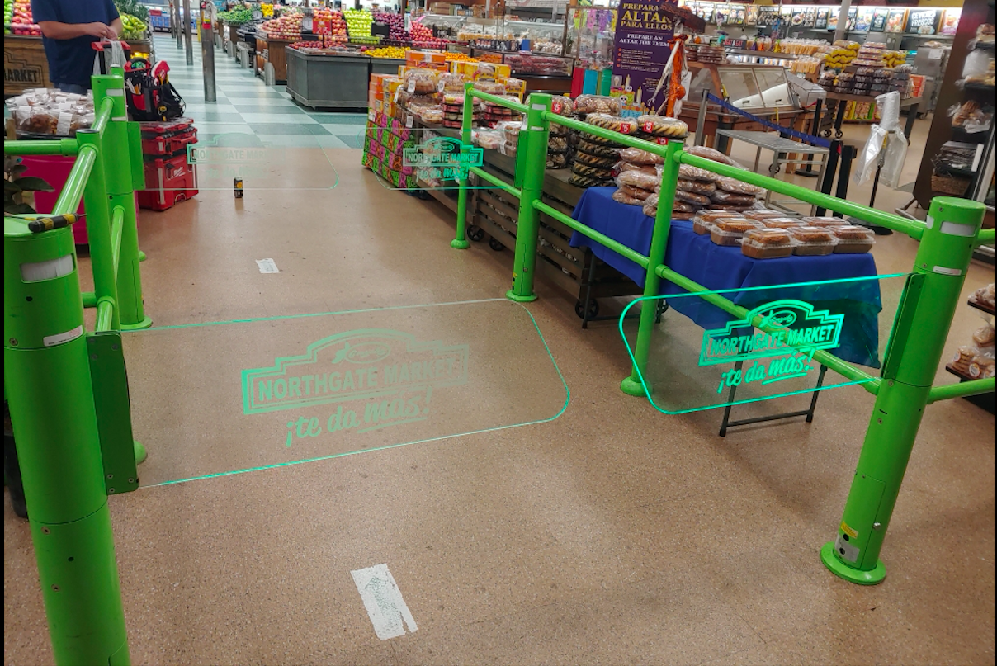
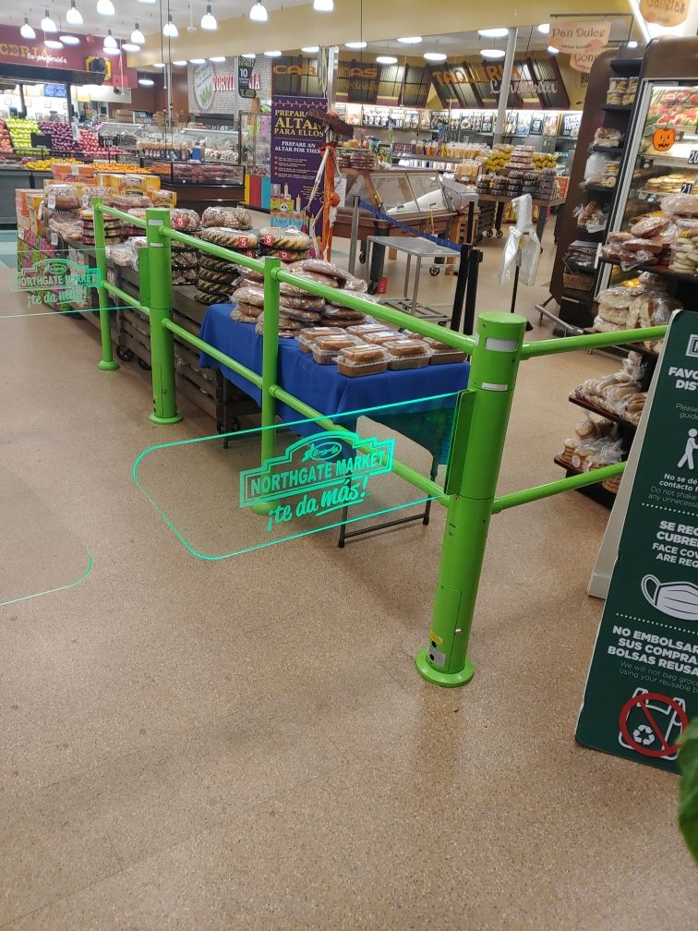
Appearance Package
Custom Shatterproof Glass Arm with LED signage
Custom powder coated railing, post and gates to match the stores aesthetics and decor

Slide 9
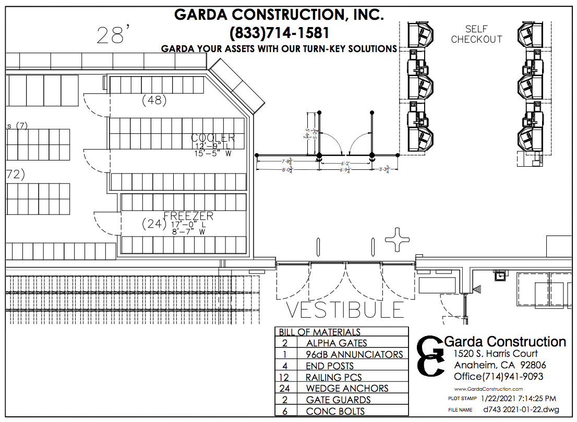
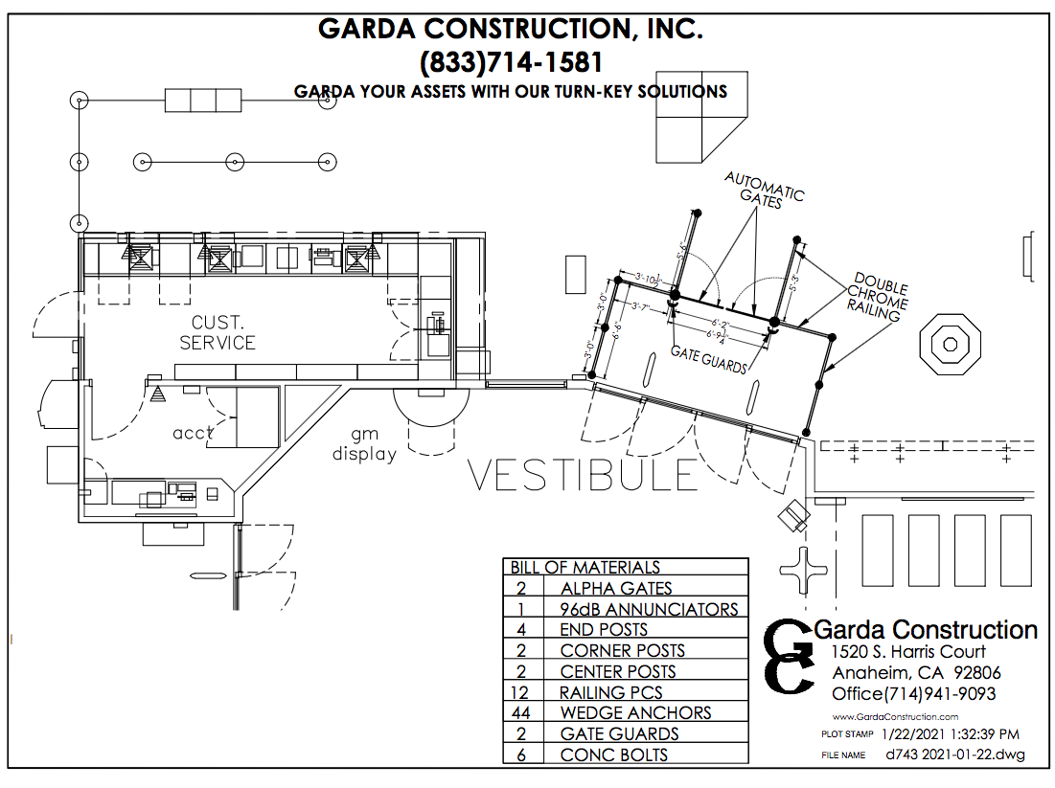
A couple of layouts - our goal is to encourage customers to exit through the checkstands

Slide 10
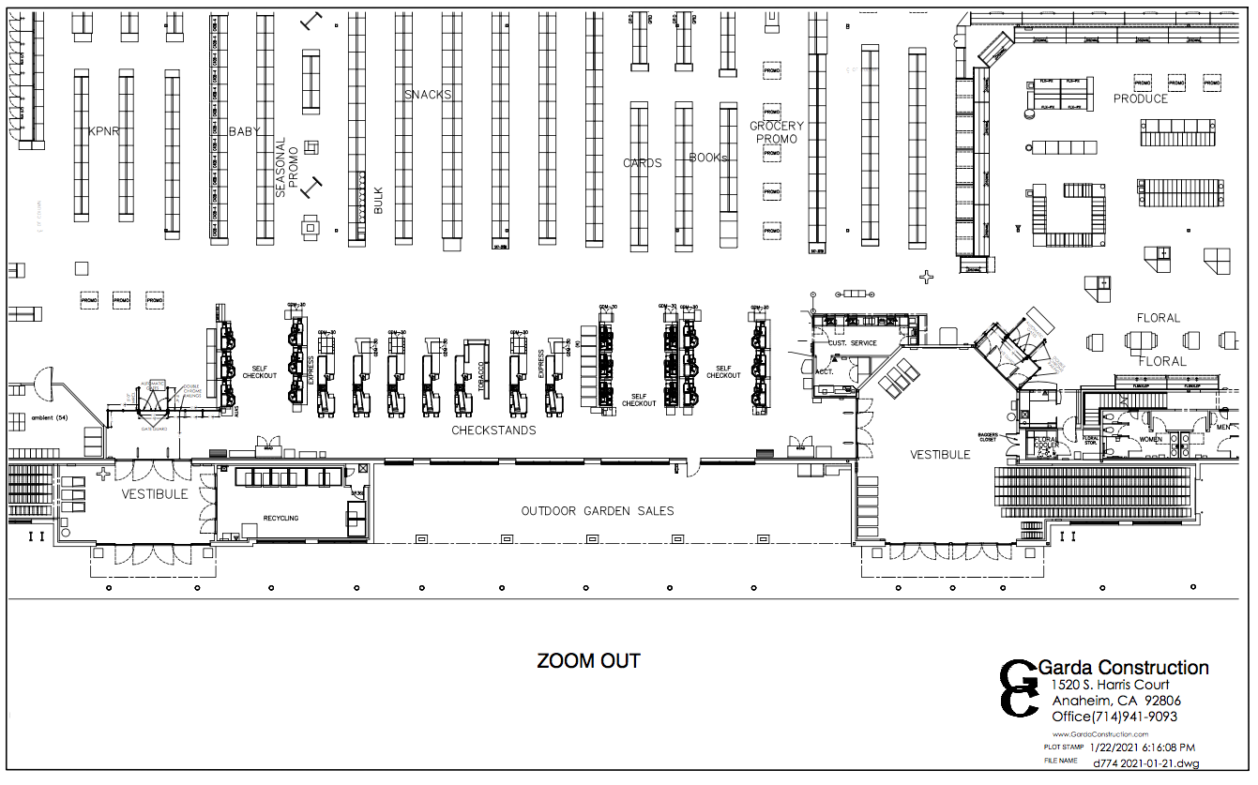
Full Store Layout to show the flow of traffic

